Slide 1
Unconditionally Secure Quantum Bit Commitment
Ping He Guang. (2019) Unconditionally secure quantum bit commitment based on the uncertainty principle Proc. R. Soc. A. 4752018054320180543
http://doi.org/10.1098/rspa.2018.0543

Slide 2

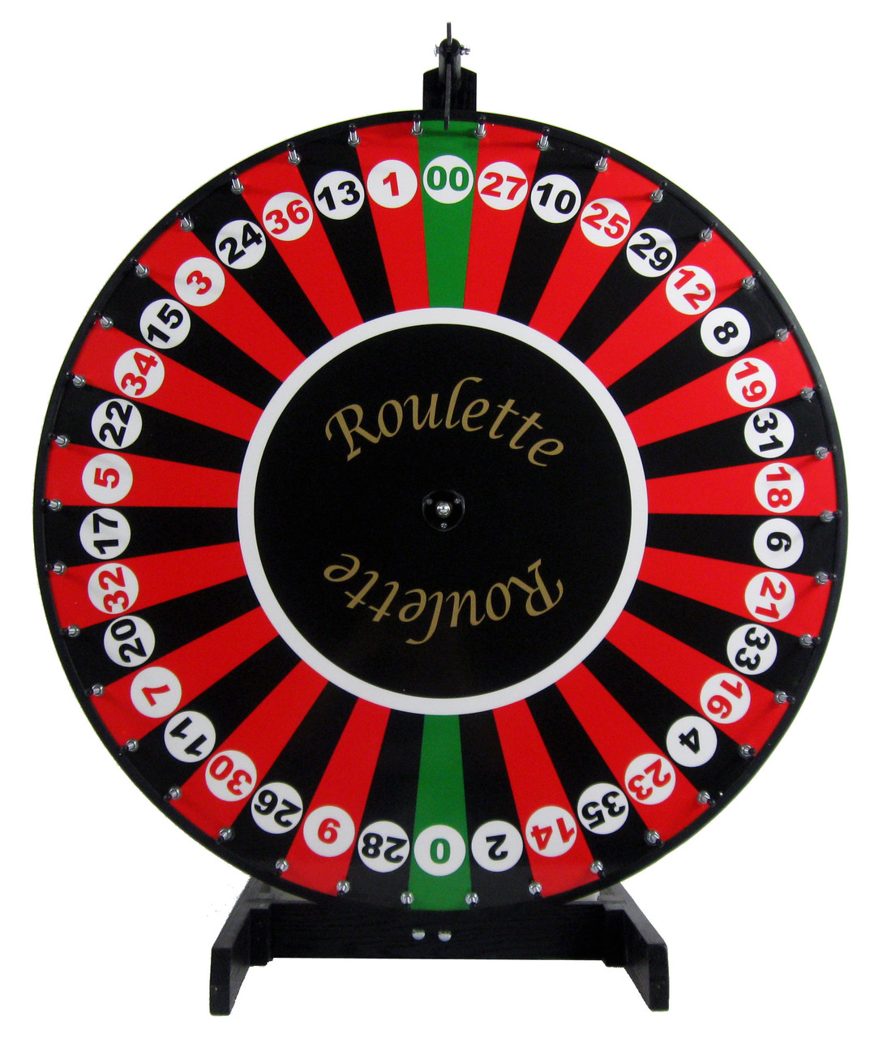
I think it will be green
Nope, red
Okay, now it’ll be red
Landed on green, pay up

Slide 3
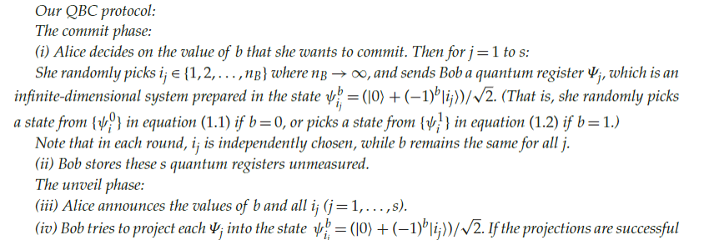
The protocol

Slide 4

Bob cheating
Bob could only cheat in this scenario by being able to somehow distinguish what state Alice sent her quantum register in. However, the equation below describes the maximum probability that he will be able to distinguish between two quantum states, and it is easy to see that it approaches 0 with sufficiently large n (He 3.1)

Slide 5



Alice cheating
Alice’s ability to cheat is also severely limited by the fact that n must be a finite numbery; else, arbitrarily large n will make the plus and minus states she chooses closer together, but it will eventually reach a point where the uncertainty principle dictates that they will be nearly indistinguishable because of the limit on the precision of measurement devices.
The upper limit on n (in equation 2) will give a finite probability that Alice will pass through all of Bob’s checks, and Bob can then use that number to force Alice to repeat the protocol for a sufficiently high s (as indicated in equation 3) to give him enough confidence.

